Slide 1
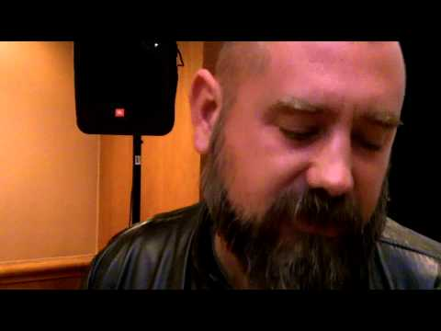

Slide 2
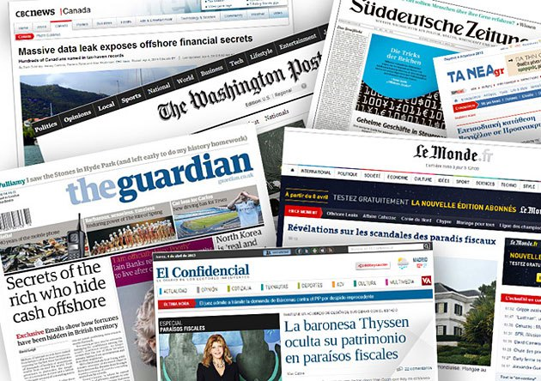

Data Journalism:
What and why
@PaulBradshaw, MED7373 Data Journalism
MA Data Journalism, Birmingham City University #bcujournos

Slide 3
Key points:
The industry and data
‘Seeing’ data in a quantified society
Contested definitions and how they can help us

Slide 4
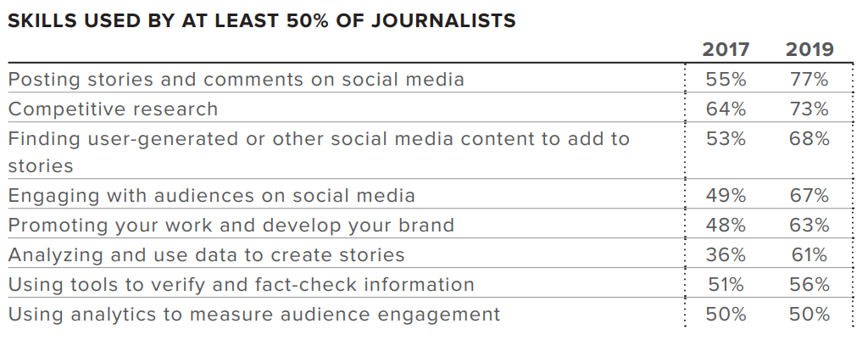
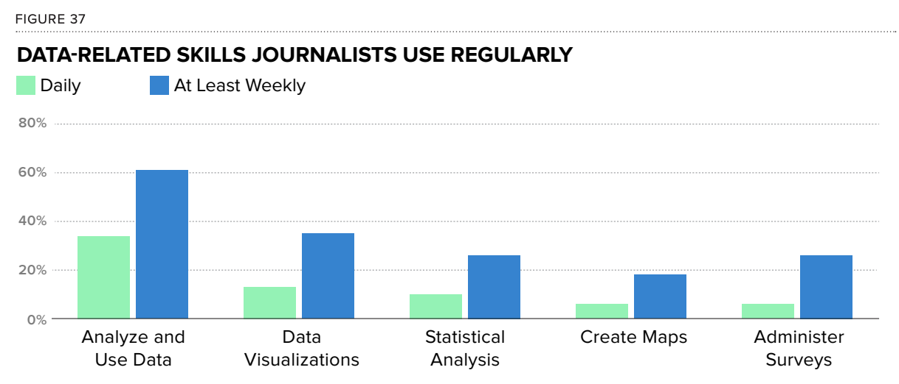
https://www.icfj.org/sites/default/files/2019-10/2019%20Final%20Report.pdf
https://newslab.withgoogle.com/assets/docs/data-journalism-in-2017.pdf

Slide 5
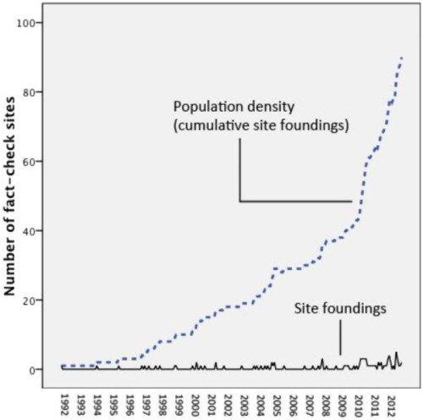
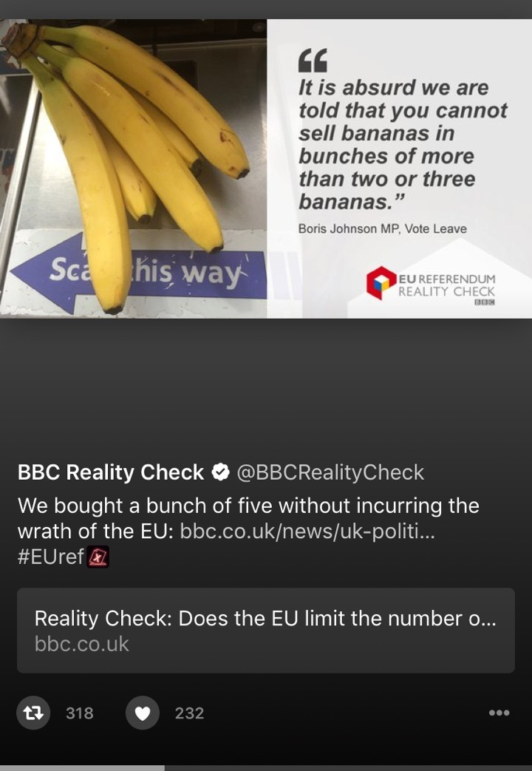
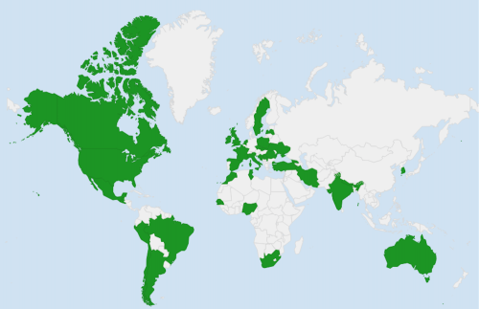
Lowrey 2015; Reporters Lab 2016

Slide 6
“The BBC has a plan to develop data journalism as a cornerstone of its reporting and analysis in all areas of News coverage.”
BBC

Slide 7
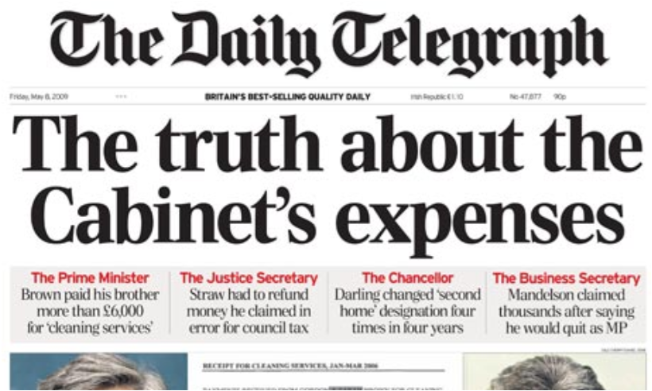
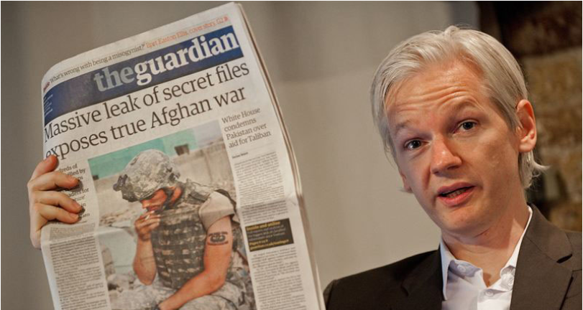

Slide 9
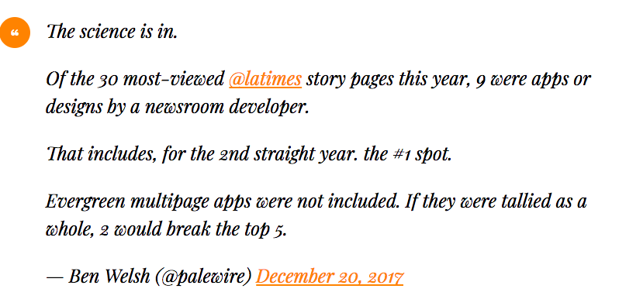
https://policyviz.com/podcast/episode-110-ben-welsh/

Slide 10
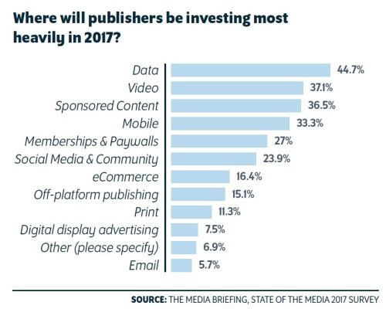
https://twitter.com/mediavoicespod/status/800673364935262208

Slide 11
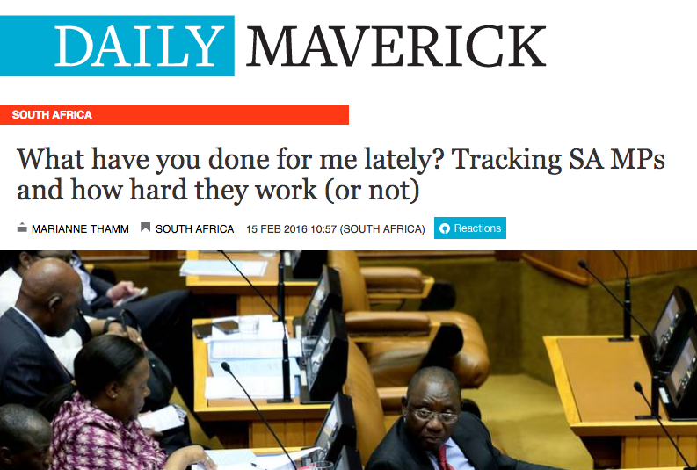
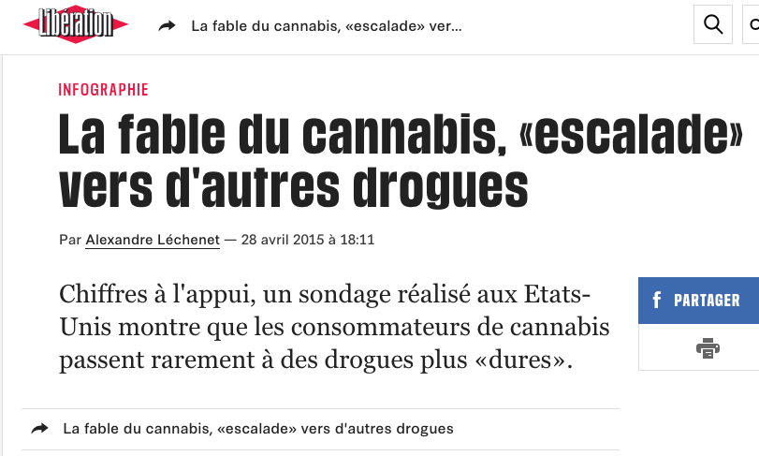
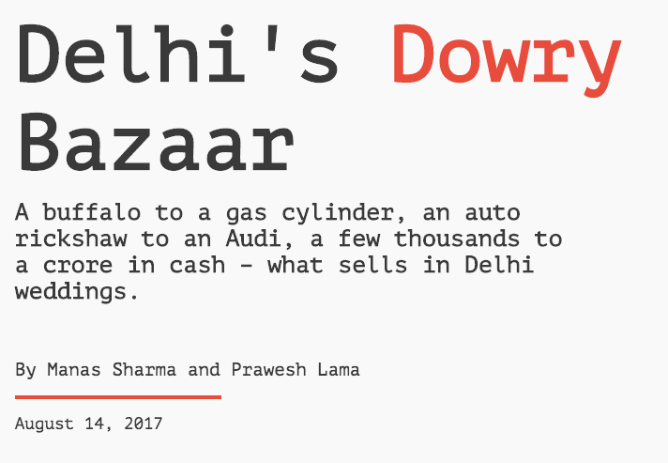

Slide 12
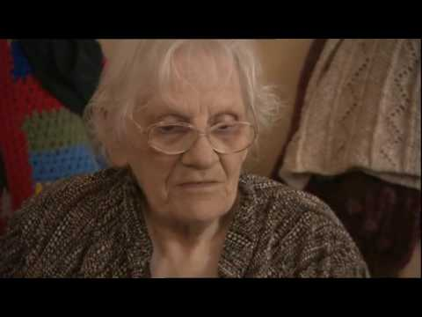
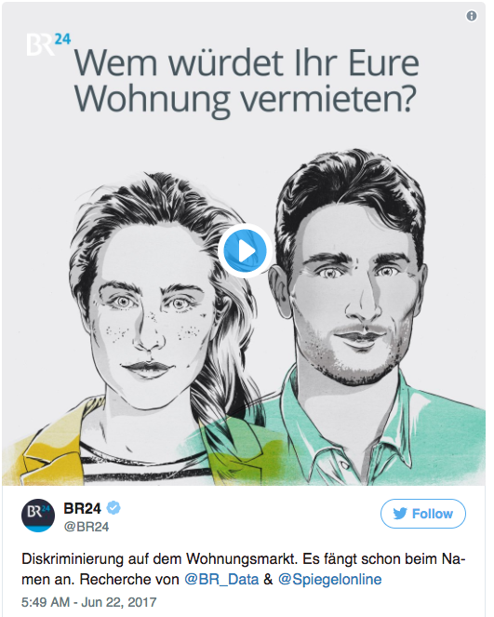
https://onlinejournalismblog.com/2017/06/26/data-journalism-in-broadcast-news-video/

Slide 13
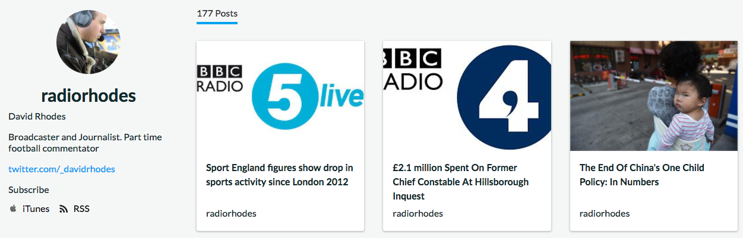
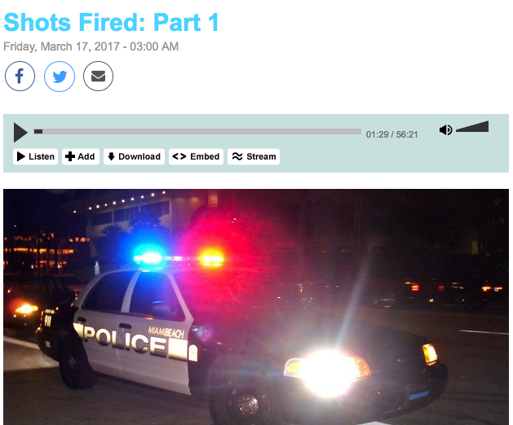
https://audioboom.com/radiorhodes
http://www.radiolab.org/story/shots-fired-part-1/
https://onlinejournalismblog.com/2017/07/06/data-journalism-on-radio-audio-and-podcasts/

Slide 14
What is data journalism?

Slide 15
“[A] data journalism artefact is likely but not necessarily a Web-based journalistic piece that is based on data collection and analysis, in other words it cannot be done without data, its essence and core is data. In addition, the main data journalistic approach is quantification.”
Alla Rybina, Operationalization of Data Journalism (DataJ Conf, 2017)

Slide 16
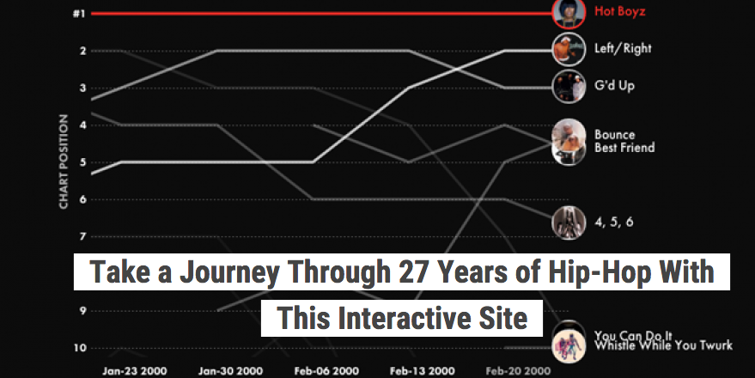
http://poly-graph.co/hiphop/

Slide 17
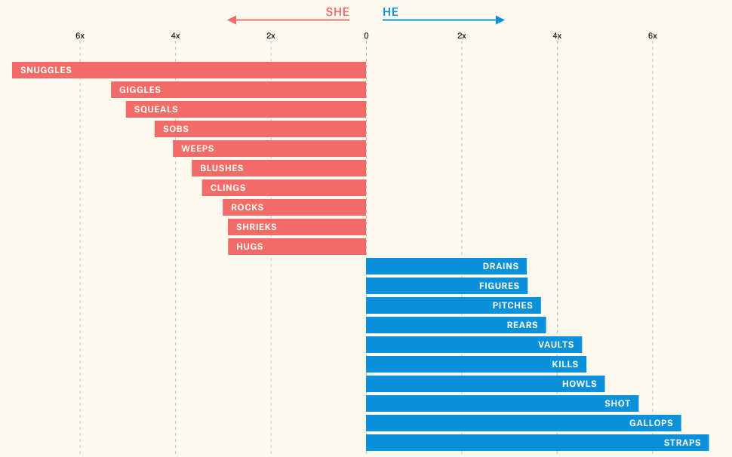
https://pudding.cool/2017/08/screen-direction/
https://github.com/juliasilge/women-in-film

Slide 18

http://www.bbc.co.uk/news/resources/idt-79ccb1e7-d390-44c1-8857-cfcb0ade2595

Slide 19
“Data journalism is simply, journalism.
...ultimately, it is just a way of describing journalism in the modern world.”
The Bureau of Investigative Journalism, https://www.thebureauinvestigates.com/explainers/what-is-data-journalism

Slide 20
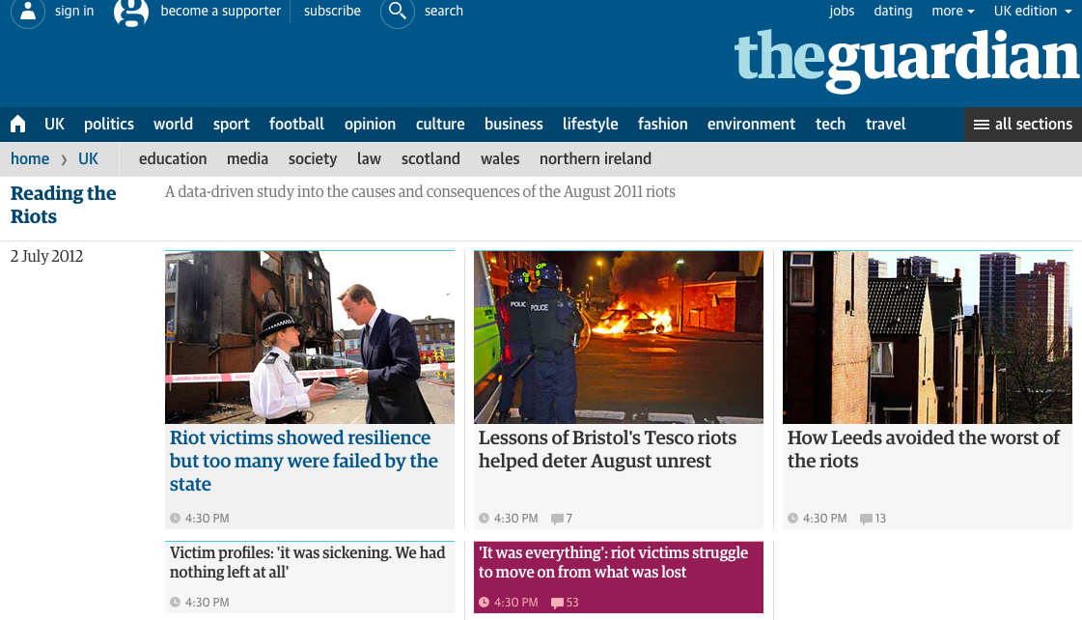
https://www.theguardian.com/uk/series/reading-the-riots

Slide 21
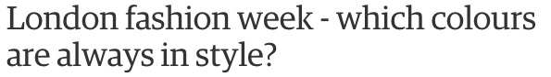
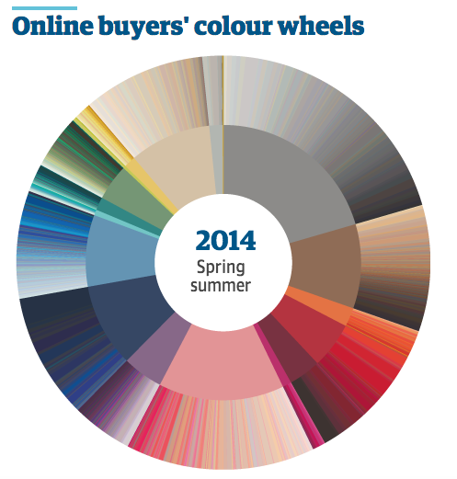
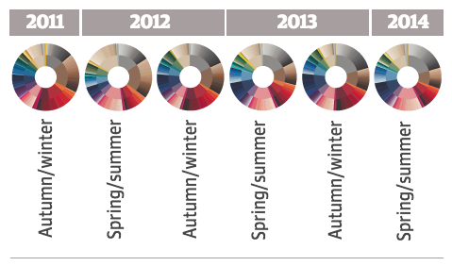
http://www.theguardian.com/news/datablog/ng-interactive/2014/sep/11/london-fashion-week-which-colours-are-always-in-style

Slide 22

https://www.thisiscolossal.com/2021/04/owen-phillips-mr-rogers/

Slide 23
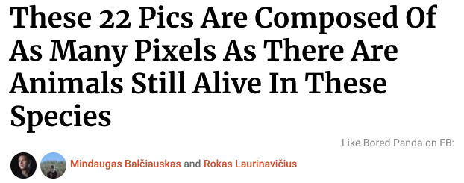
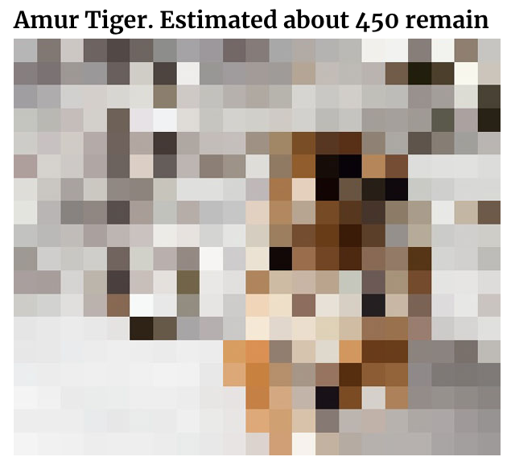
https://www.boredpanda.com/endagered-animals-pixels-extinction/

Slide 24
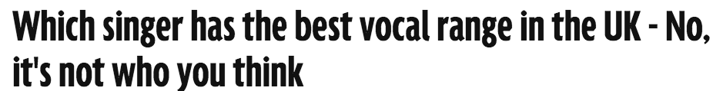
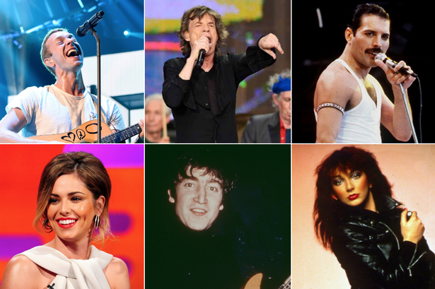
http://www.mirror.co.uk/news/uk-news/singer-best-vocal-range-uk-4323076

Slide 25
IDEA
DATA
DATA
IDEA
STORY
STORY

Slide 26
‘Computational journalism’
“We define computational journalism as the combination of algorithms, data, and knowledge from the social sciences to supplement the accountability function of journalism.”
James T. Hamilton & Fred Turner (2009) http://web.stanford.edu/~fturner/Hamilton%20Turner%20Acc%20by%20Alg%20Final.pdf

Slide 27
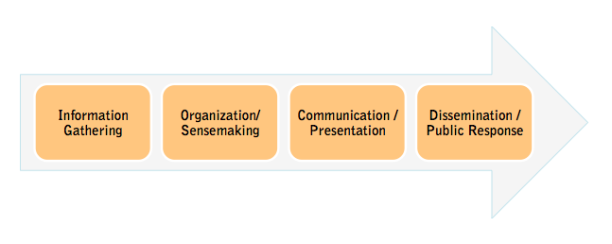
“I define Computational Journalism as the application of computing to the activities of journalism including information gathering, organization and sensemaking, communication and presentation, and dissemination and public interaction with news information, all while upholding values of journalism such as balance, accuracy, and objectivity.”
Nikolas Diakopoulos (2010) http://www.nickdiakopoulos.com/2011/04/22/a-functional-roadmap-for-innovation-in-computational-journalism/

Slide 28
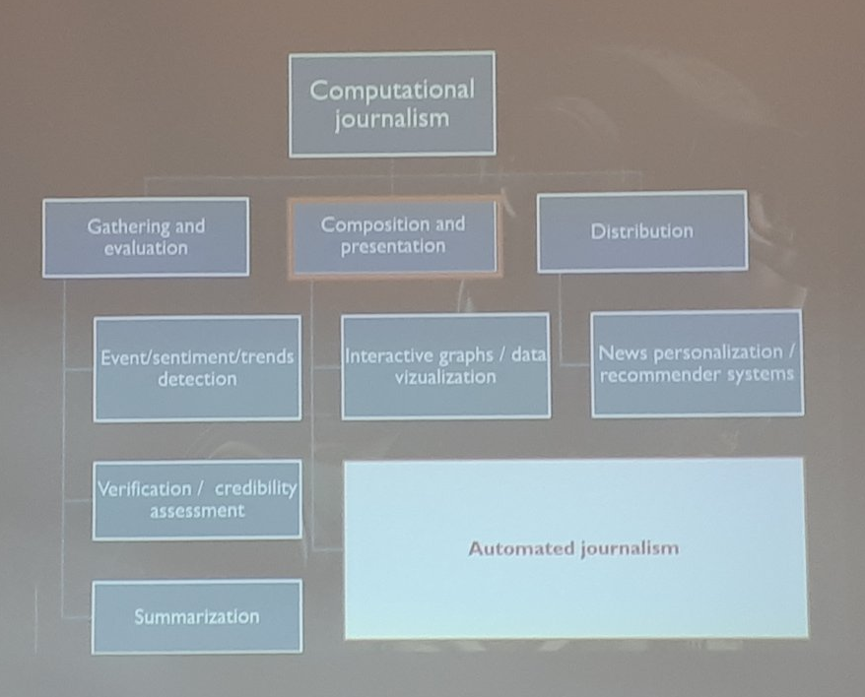

Slide 29
Anderson’s typology
Journalism of occurrences (events, oral evidence) - traditional journalism
Journalism of social science (context via statistics) - data journalism
Computational journalism (context via computable 'events') - automated/robot
Chris Anderson (2018)
Apostles of Certainty

Slide 30
‘Robot journalism’
“Algorithmic processes that convert data into narrative news texts with limited to no human intervention beyond the initial programming””
“The broadening reliance on algorithms to generate news automatically”
Matt Carlson (2014) / Tal Montal and Zvi Reich (2016)
http://www.tandfonline.com/doi/abs/10.1080/21670811.2014.976412 http://www.tandfonline.com/doi/full/10.1080/21670811.2016.1209083

Slide 31
‘Augmented journalism’
“This is all about “automation” — reducing human effort … But [it also] incorporates many
forms of … “artificial intelligence,” or “cognitive technologies.””
Francesco Marconi, Alex Siegman and Machine Journalist (2017) https://insights.ap.org/uploads/images/the-future-of-augmented-journalism_ap-report.pdf

Slide 32
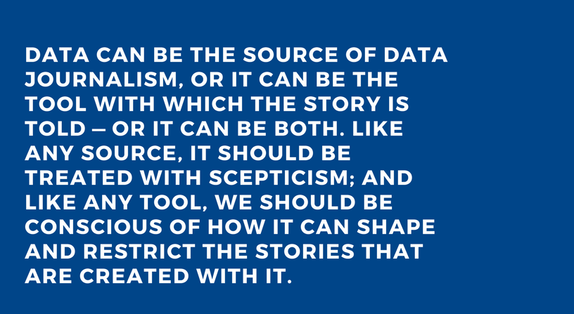
Paul Bradshaw, Data Journalism Handbook http://datajournalismhandbook.org/1.0/en/introduction_0.html

Slide 33
The ability to generate newsworthy story ideas for a particular audience;
to obtain, clean, contextualise (e.g. statistically) and analyse relevant data in order to find that story;
and communicate that story effectively, ethically and accurately (e.g. indicating uncertainty or important context) for the target audience
Paul Bradshaw

Slide 34
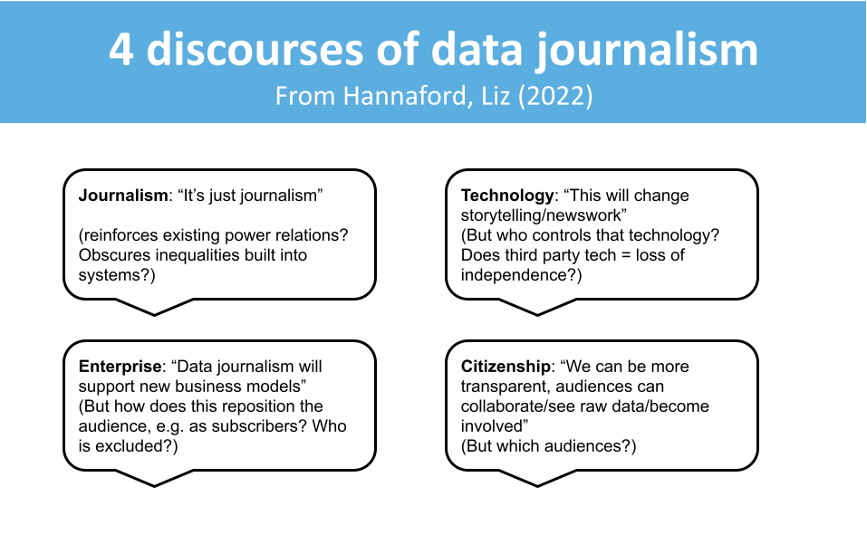
https://e-space.mmu.ac.uk/629840/

Slide 35
Takeaways:
Data journalism is lots of things - but few people can do them all
Look for data journalism ideas in anything that’s quantifiable
Be critical: how does automation, augmentation and quantification shape our work?

Slide 36
Now, let’s do something.

Slide 37
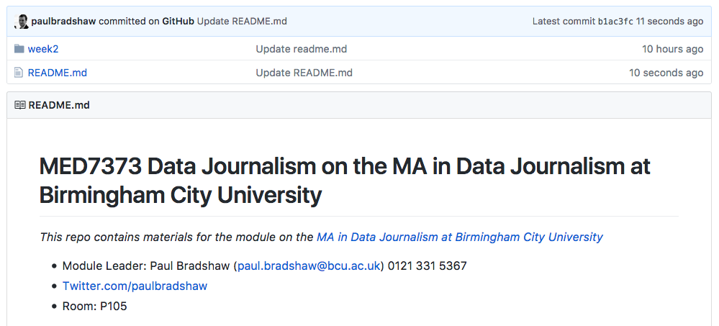
“Fork this repo”
https://github.com/paulbradshaw/MED7373-Data-Journalism/tree/master/1basics

